Slide 1
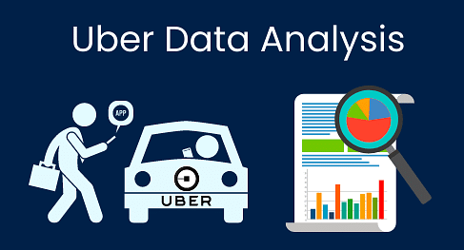
UBER DATA ANALYSIS
GROUP : “ALPHA”
Rajesh Kumar - 11900121072
Pritam Chakraborty - 11900121103
Aryan Harsh – 11900121099
Sanjoy Dey - 11900121092
Himanshu Mishra - 11900121089
Abhishek Roy - 11900121081

Slide 2
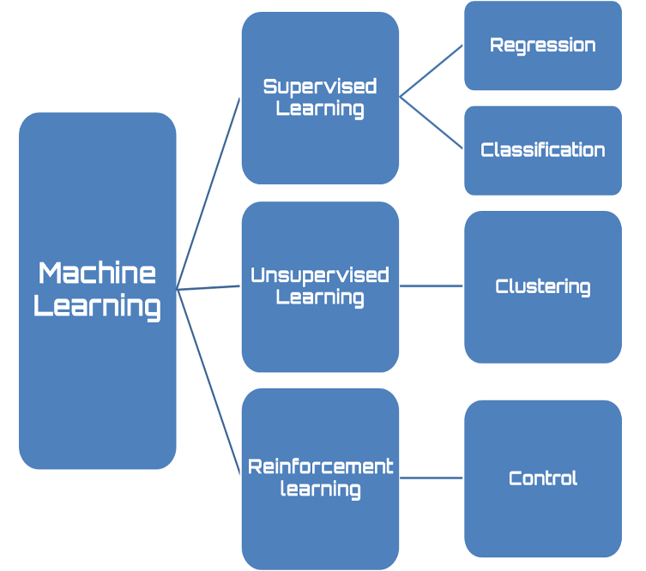
MACHINE LEARNING
Machine learning (ML) is a type of artificial intelligence (AI) that allows software applications to become more accurate at predicting outcomes without being explicitly programmed to do so. Machine learning algorithms use historical data as input to predict new output values.
Machine learning is important because it gives enterprises a view of trends in customer behavior and business operational patterns, as well as supports the development of new products. Many of today's leading companies, such as Facebook, Google and Uber, make machine learning a central part of their operations. Machine learning has become a significant competitive differentiator for many companies.
Types of Machine Learning

Slide 3

INTRODUCTION
Uber is a transportation company with
an app that allows passengers to hail
a ride and drivers to charge fares and
get paid.
More specifically, Uber is a ridesharing
company that hires independent
contractors as drivers.
It's one of many services today that
contribute to the sharing economy,
supplying a means of connecting
existing resources instead of providing
the physical resources themselves.
Uber is an international company located in 69 countries and around 900 cities around
the world.

Slide 4


PROBLEM STATEMENT
With over 118 million users, 5 million drivers, and 6.3 billion trips with 17.4 million trips completed per day - Uber is the company behind the data for moving people and making deliveries hassle-free.
How are drivers assigned to riders cost-efficiently?
how is dynamic pricing leveraged to balance supply
and demand?
How many times have I traveled in the past?
How many trips were completed and canceled?
What a measure. fare, distance, amount, and time
spent on the ride?*

Slide 5
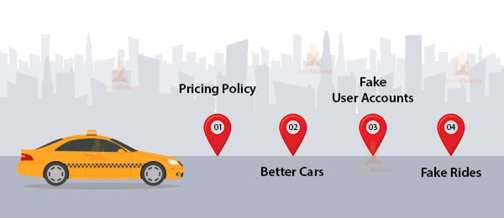
CHALLENGES
Finding the best regression algorithm, among Linear Regression for our problem was a challenge.
Collecting meaningful data.
Select the original user accounts.
Finding the best cars for the user comfort.
With the high volume of data available
for businesses, collecting meaningful data
is a big challenge.
Among all the fake rides, select the right
analytics tool.

Slide 6

SOLUTION APPROACH
"UberDataset.csv" dataset was taken from uber.com and was reconﬁgured to reﬂect the important features.
Categorical features were then converted to numerical values.
We use tensorflow , pandas,numpy for implementing the graph.
We have deleted null or duplicate values from data set.
We created a scatter different types of bar plots to analysis the data.

Slide 7
LIBRARIES USED
import numpy
numpy is a Python library used for working with arrays. It also has functions for working in domain of linear algebra, Fourier transform, and matrices.
import pandas
pandas is a game changer, and it is one of the most popular and commonly used tools in data analytics. pandas is that it takes data from a CSV or TSV file or a SQL database and generates a Python object with rows and columns called a data frame, which looks remarkably similar to a table in statistics tools like Excel. Working with this is far more convenient than dealing with lists and/or dictionaries.
import matplotlib
matplotlib is a python library used to create 2D graphs and plots by using python scripts. It has a module named pyplot which makes things easy for plotting by providing feature to control line styles, font properties, formatting axes etc.

Slide 8
LIBRARIES USED
import seaborn
The import seaborn portion of the code tells Python to bring the Seaborn library into your current environment. The as sns portion of the code then tells Python to give Seaborn the alias of sns. This allows you to use Seaborn functions by simply typing sns.function_name rather than seaborn.function_name.
from sklearn.model_selection import train_test_split
The Sklearn train_test_split function splits a dataset into training data and test data.
from sklearn.preprocessing import standardscaler
standardscaler removes the mean and scales each feature/variable to unit variance. This operation is performed feature-wise in an independent way. standardscaler can be influenced by outliers (if they exist in the dataset) since it involves the estimation of the empirical mean and standard deviation of each feature.

Slide 9
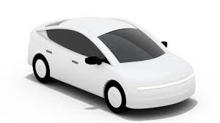
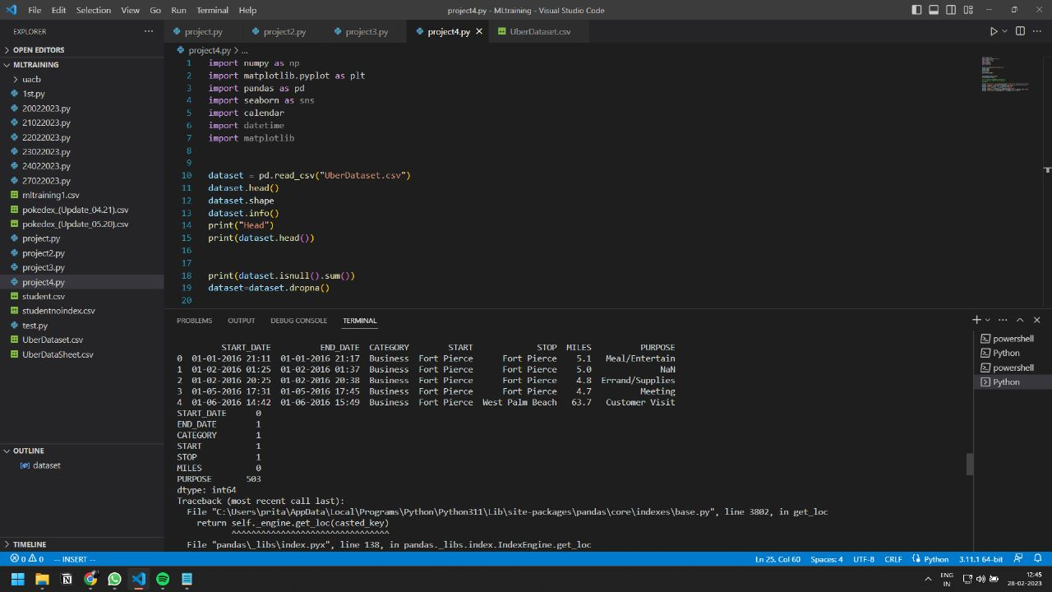
DATASET
The data we have used in this project was in csv.file. It was taken from uber.com . The dataset consists of 653 rows and 7 columns with no null values. Column data consist of independent Features. The independent features contain both categorical and numeric values.

Slide 10
DATA READING
It is the data that we need to load for starting any of the ML project. With respect to data, the most common format of data for ML projects is CSV (comma-separated values). Basically, CSV is a simple file format which is used to store tabular data (number and text) such as a spreadsheet in plain text.

Slide 11
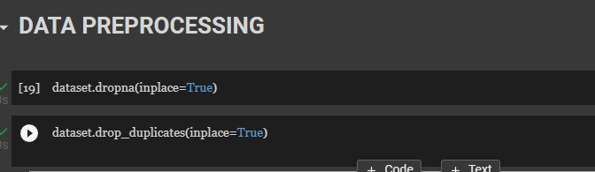
DATA PROCESSING
Data Processing is the task of converting data from a given form to a much more usable and desired form i.e. making it more meaningful and informative.

Slide 12
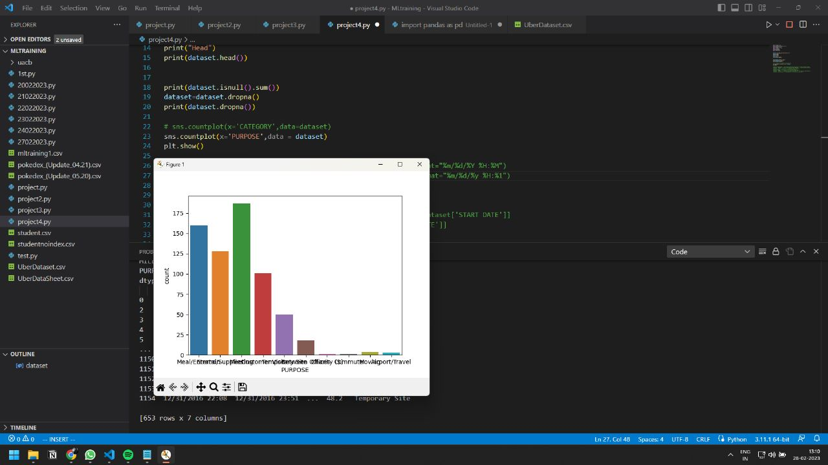
DATATIME OPERATION
The DATETIME type is used for values that contain both date and time parts. MySQL retrieves and displays DATETIME values in ' YYYY-MM-DD hh:mm:ss ' format

Slide 13
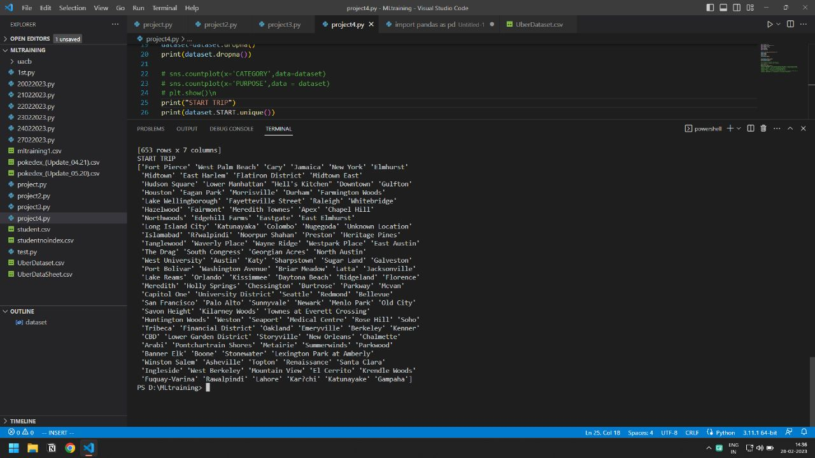
DATATIME PROFILING
Data profiling is a technique used to analyze and gain a better understanding of raw data.

Slide 14
OBSERVATION
In this project,
We have imported different type of python module(tensorflow, pandas, numpy, matplotlib).
Then after getting the output of dataset ,we have cleaned the dataset that whether the dataset has any null value or duplicate value or not.
Then we have done data preprocessing before doing data visualization.
We used data visualization to plot the bar graph on different parameters for checking the dependencies of different situation.
Thus by this following steps we observe different kind of plotting and by comparing different kind of labelled data and we have plotted it .

Slide 15
RESULTS
Project name : UBER DATA ANALYSIS
CONTRIBUTION :
1.Rajesh Kumar - Data Profiling, Data Visualization
2.Pritam Chakraborty - Data Processing, Data Visualization
3.Sanjoy Dey - Data Processing ,Reading data, PPT Making
4.Abhishek Roy - Data cleaning , Document Making
5.Aryan Harsh - Data time Operation, Document Making
6.Himanshu Mishra - Data time Operation, Document Making
github link : https://github.com/Pritam7029/uber_data_analysis_python

Slide 16
CONCLUSION
We looked at two different types of Uber ride datasets – a personal ride history for a single person and a two-month record of all the Uber rides in Boston, MA. We compared similar graphs in the EDA process of both these datasets to generate real-world insights into the behavior of the Uber riders and trips in the city of Boston. Furthermore, we used different ML models to perform a price prediction of the Uber ride based on a fixed number of features from the second dataset. We also perform feature selection to reduce the number of features and find the optimal amount to improve model performance to a certain degree.
Finally, we noted some crucial issues faced by scientists during EDA and data analysis and listed the challenges of working with the Uber datasets.

Slide 17


CREDITS: This presentation template was created by Slidesgo, including icons by Flaticon, and infographics & images by Freepik and illustrations by Stories

